Slide 1
Augmented Information Retrieval
Julia Scheel, Tom Gebhardt, Olaf Wolkenhauer

Slide 2
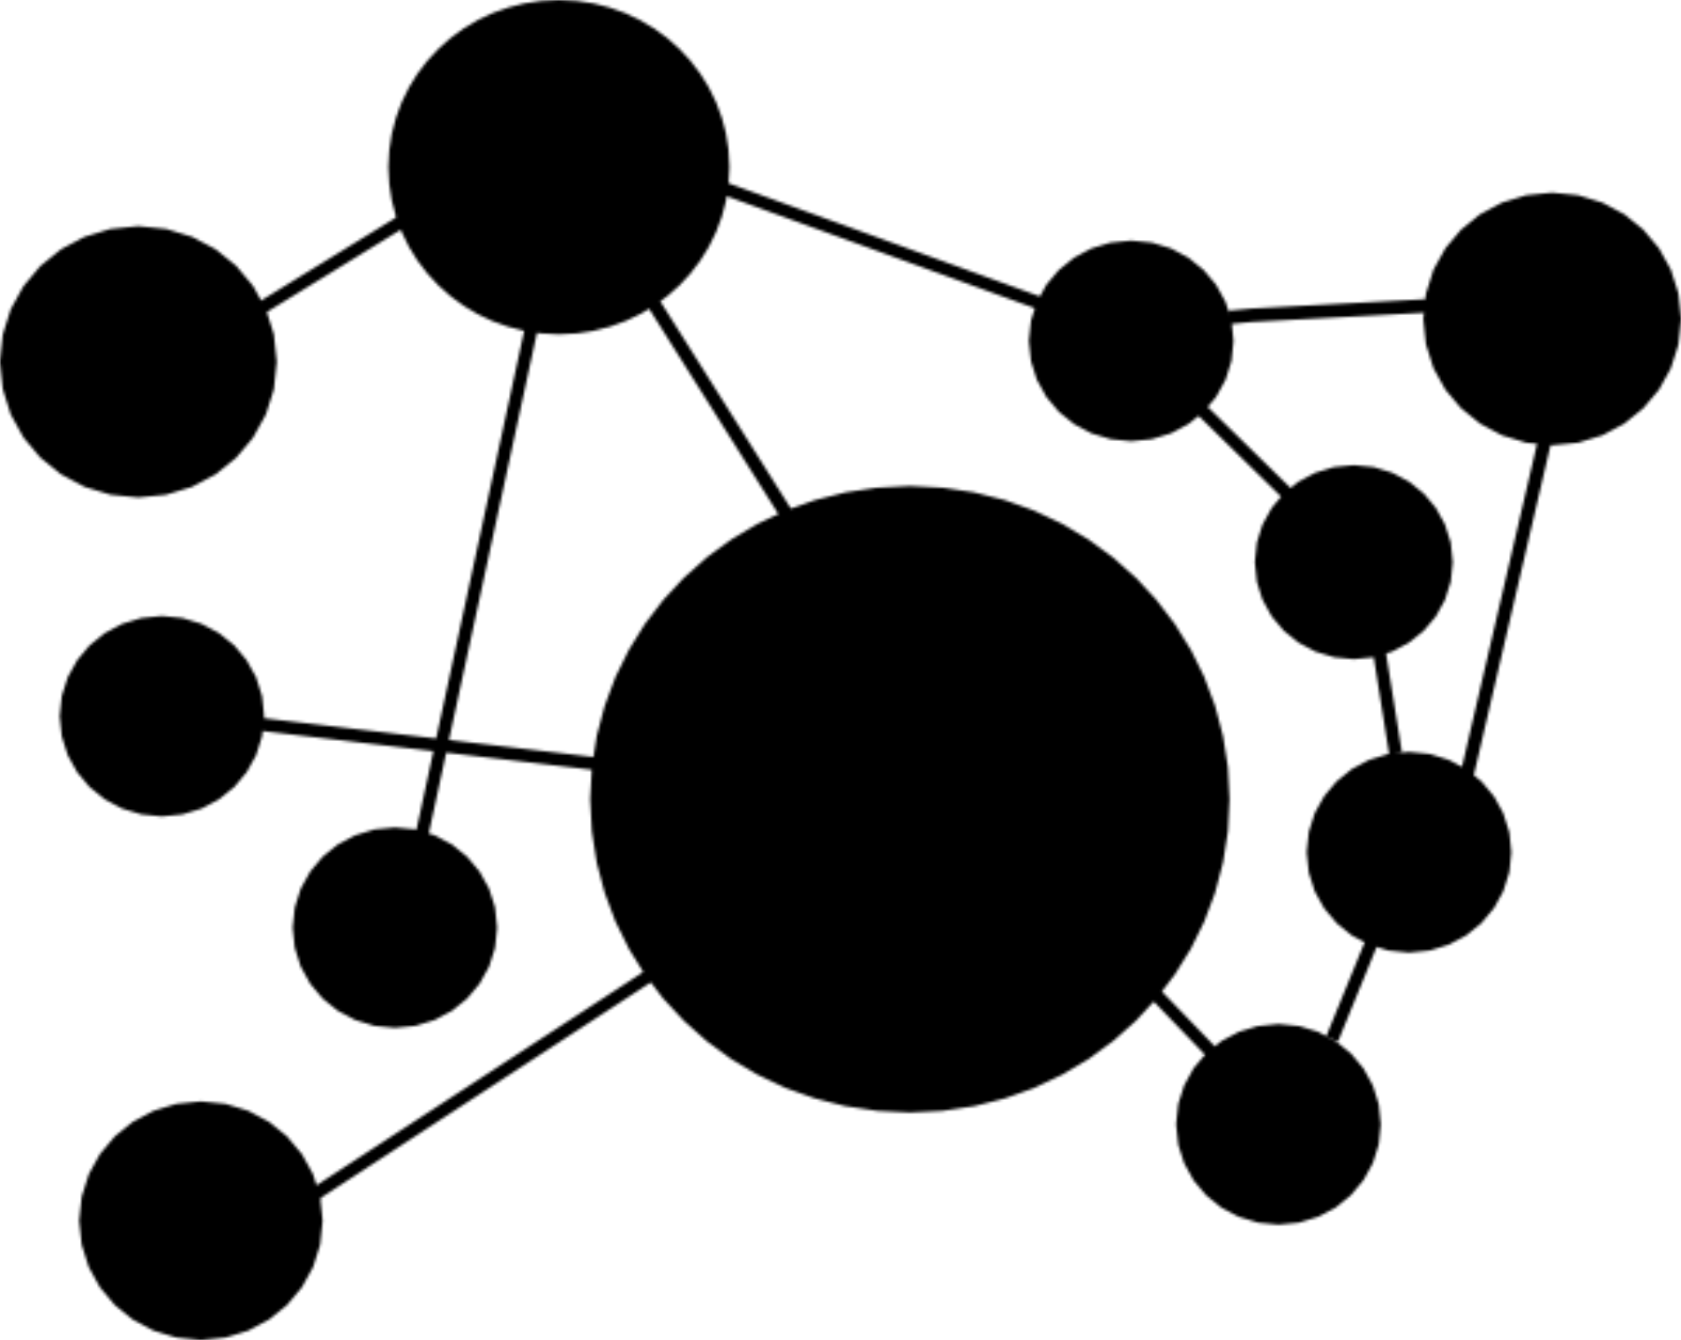
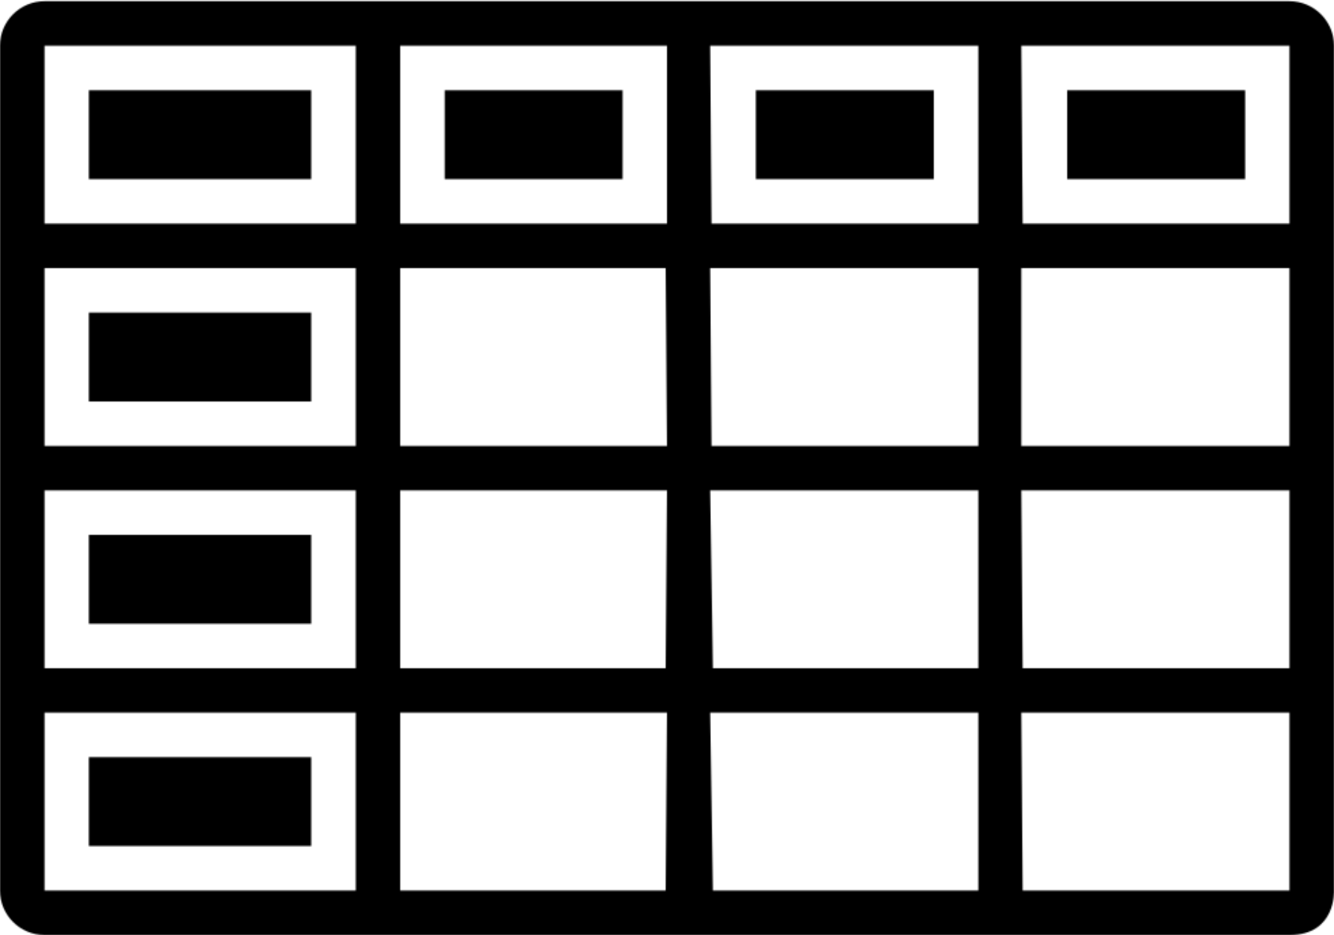
Motivation
When collaborating with a company, our team was asked to investigate how their medical product works and whether it is effective. Therefore:
Several researchers and students read vast amounts of publications
Spending hours and days to identify the relevant molecular interactions
Converting the textual information into a tabular format
Connecting it to databases
And finally constructing a molecular interaction map (network) from the table
Afterwards the map gets revised, corrected and extended, making it a iterative process

Slide 3
Aim of the project
Reduce required time and resources to extract information
Identify the requirements of the tool by interviewing a „customer“ with a background in molecular biology and computer science
Investigate the standard workflow to draft a tool
The tool should be able to screen a scientifc paper and augment it to ease information retrieval

Slide 4
Get in touch!
julia.scheel@uni-rostock.de & tom.gebhardt@uni-rostock.de

